Slide 1
Offset Bin Classiﬁcation Network for Accurate Object Detection
作者：Heqian Qiu, Hongliang Li∗, Qingbo Wu, Hengcan Shi
University of Electronic Science and Technology of China
Chengdu, China
日期 : 2021/3/11

Slide 2
Abstract
本文提出利用
1.cross entropy loss 進行優化的偏移量分類網路，以預測更精確的偏移量
2.基於期望值的偏移預測和分層聚焦方法(hierarchical focusing method)，來提高預測精確度
避免了誤差太大時會造成梯度爆炸的問題

Slide 3
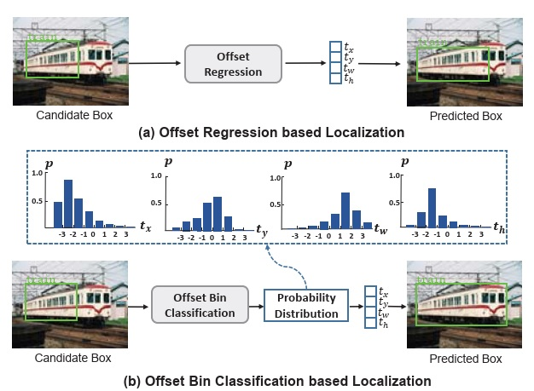
Introduction
基於偏移回歸的定位
smooth L1+L2 loss
基於offset bin分類的定位
cross entropy loss

Slide 4
Object Detectors
檢測器
Single-stage ex: YOLO、SSD、RetinaNet
Two-stage ex: Faster R-CNN、FPN、Mask R-CNN
 | Single-stage | Two-stage
速度比較 | 快 | 慢
Region proposal | 跳過 | 產生

Slide 5
Bounding Box Regression
目的：解決目標定位的問題
方法：利用Bbox回歸網路去預測，將候選框轉換為目標的4個座標偏移量

Slide 6

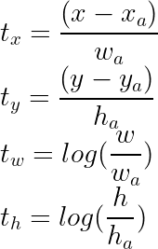
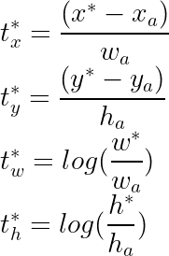


Revisiting Bbox Regression
預測偏移量
目標偏移量
X的誤差

Slide 7
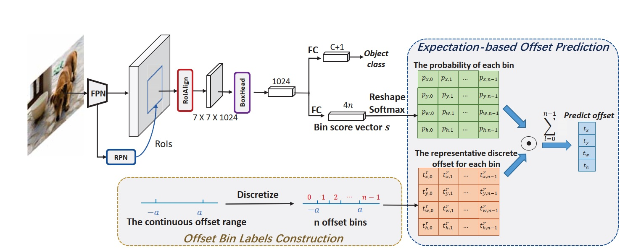
offset bin classiﬁcation architecture
1
3
2

Slide 8
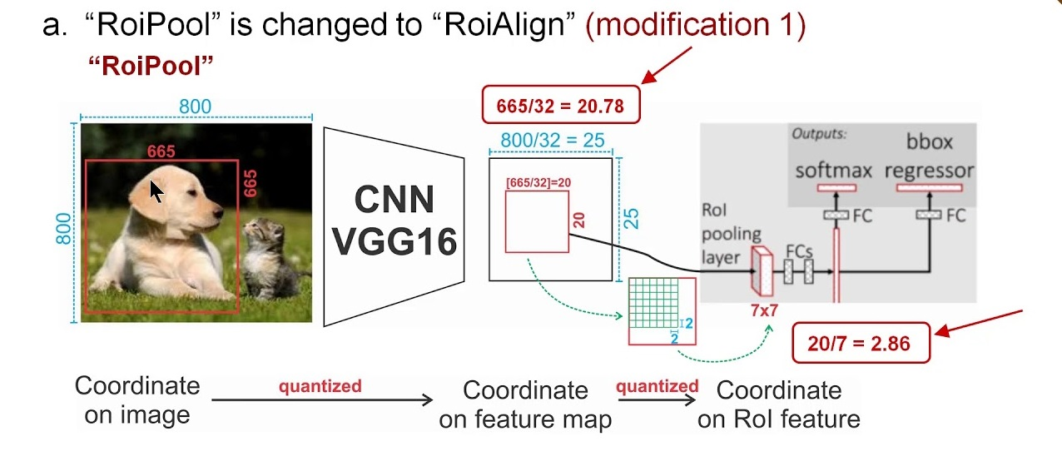
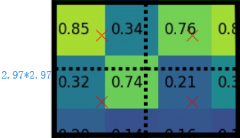
(補充) RoIPooling vs RoIAlign
665/32=20.78
20.78/7 = 2.97

Slide 9
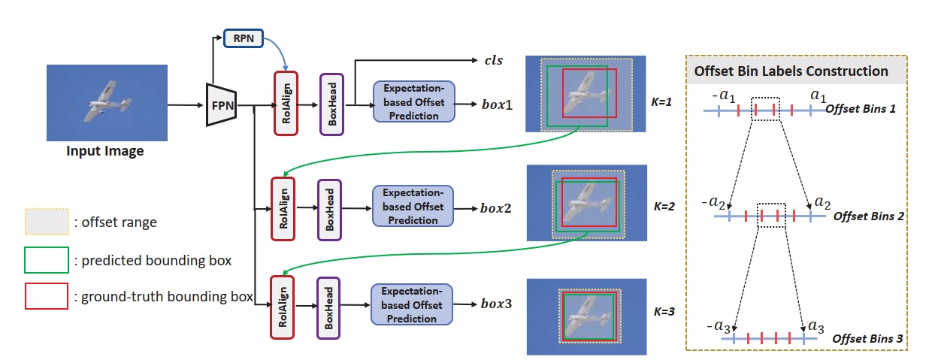
Architecture of the proposed hierarchical focusing offset prediction

Slide 10
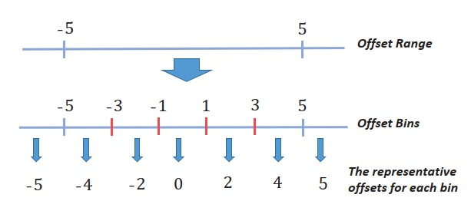
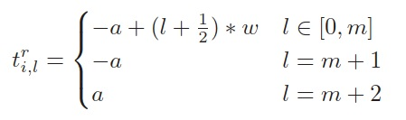
Offset bin labels construction

Slide 11




Network Learning

Slide 12
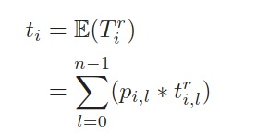


Offset Prediction
Expectation-based Offset Prediction
Hierarchical Focusing Offset Prediction
offset range (−ak, ak)
表示代表 n 個bin的預期離散偏移量

Slide 13
offset bin classiﬁcation architecture
1
3
2

Slide 14
Architecture of the proposed hierarchical focusing offset prediction

Slide 15
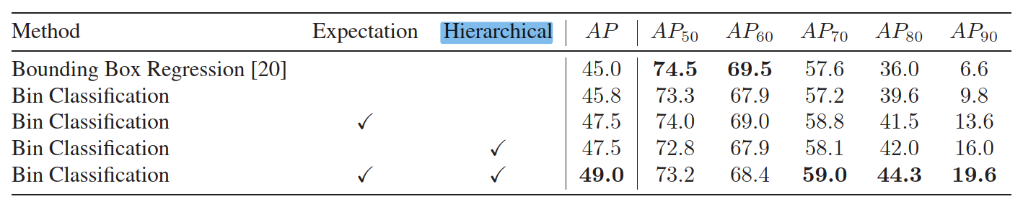
Experiment
VOC2007測試集

Slide 16
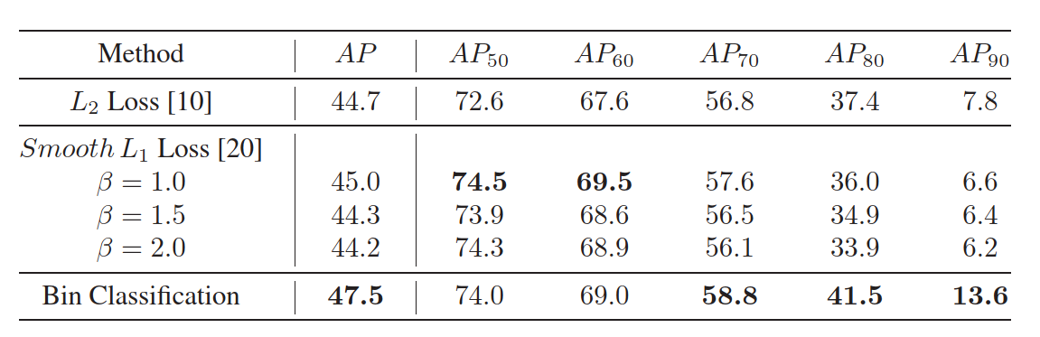
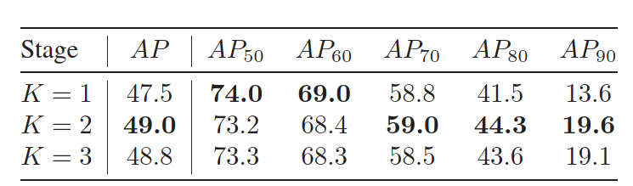
Ablation Study
Effectiveness of Different Loss Function for Predicting Offsets.
Effectiveness of number of stages

Slide 17
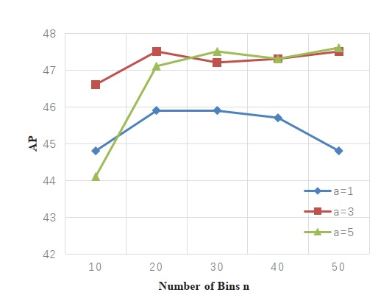
bin classiﬁcation for offset bin labels

Slide 18
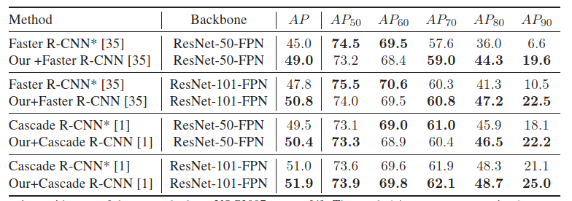
Conclusion

Slide 19
參考來源
Offset Bin Classiﬁcation Network for Accurate Object Detection
https://bbs.huaweicloud.com/blogs/114705
https://www.itread01.com/content/1544685317.html
https://paperswithcode.com/paper/offset-bin-classification-network-for

